Slide 1
Learning Objective
I will be able to determine types of stationary points
Success Criteria
At the end of the lesson, I will be able to:
Determine the types of stationary points

Slide 2
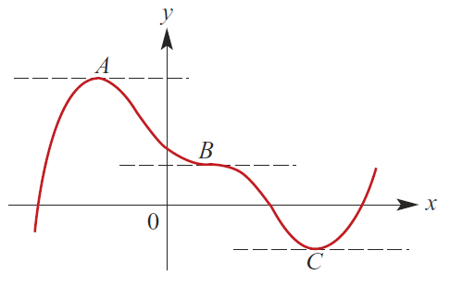
Stationary Point
Activating Prior Knowledge
If at point$x=a{, f}^{′}\left(a\right)=0$, $x=a$ is said to be a stationary point.
There are stationary points at A, B and C.
At such points, the gradient of the tangents are 0.
The stationary point at point A is called
Local maximum point
Gradient
Shape of f
+
0
-
The stationary point at point C is called
Local minimum point
Gradient
Shape of f
-
0
+

Slide 3
Concept Development
Stationary Point
The stationary point at point B is called
Stationary point of inflection
Gradient
Shape of f
-
0
-
Gradient
Shape of f
+
0
+

Slide 4
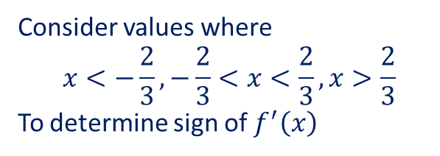

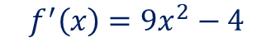

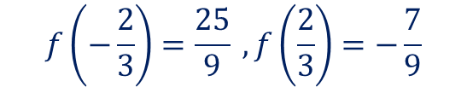

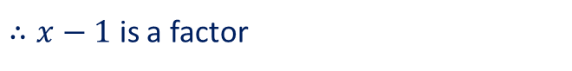


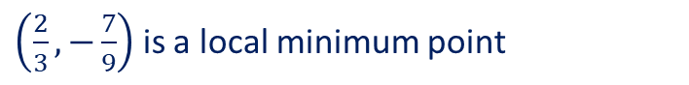




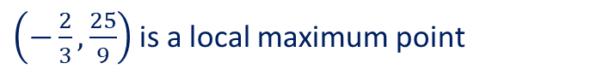
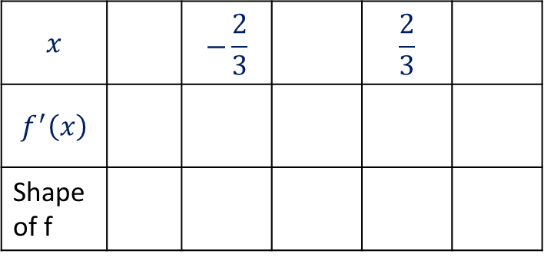
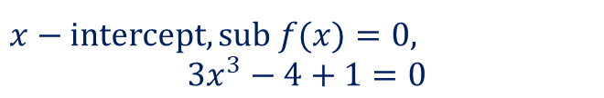



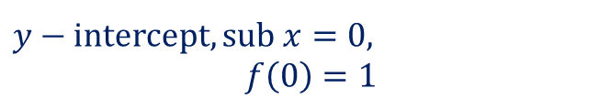
Guided Practice
Determine the stationary points and its nature of the function $f\left(x\right)=3x^{3}−4x+1$ . Sketch the graph of the function.
$$f^{′}\left(x\right)=9x^{2}−4$$
Sub$f^{′}\left(x\right)=0,$
(to find stationary points)
$\left(−\frac{2}{3},\frac{25}{9}\right)$is a local maximum point
$$9x^{2}−4=0$$
$$∴x=±\frac{2}{3}$$
$\left(\frac{2}{3},−\frac{7}{9}\right)$ is a local minimum point
$$f\left(−\frac{2}{3}\right)=\frac{25}{9} ,f\left(\frac{2}{3}\right)=−\frac{7}{9}$$
To sketch the graph, we also need other key features such as x and y intercepts and the behaviour of the graph
Consider values where
$$x<−\frac{2}{3}, −\frac{2}{3}<x<\frac{2}{3}, x>\frac{2}{3}$$
To determine sign of $f^{′}\left(x\right)$
$y−$ intercept, sub $x=0,$
$$f\left(0\right)=1$$
$x−$ intercept, sub $f(x)=0,$
$$3x^{3}−4+1=0$$
$$x$$ |  | $$−\frac{2}{3}$$ |  | $$\frac{2}{3}$$
$$f^{′}\left(x\right)$$
Shape of f
sub $x=1,$ into $f(x)$
$$f\left(1\right)=3\left(1\right)−4+1=0$$
$$−1$$
$$0$$
$$1$$
$$5$$
$$0$$
$$−4$$
$$0$$
$$5$$
$∴x−1$ is a factor
$$3x^{3}−4+1=\left(x−1\right)\left(3x^{2}+3x−1\right)=0$$
$$∴x=1, 3x^{2}+3x−1=0$$

Slide 5
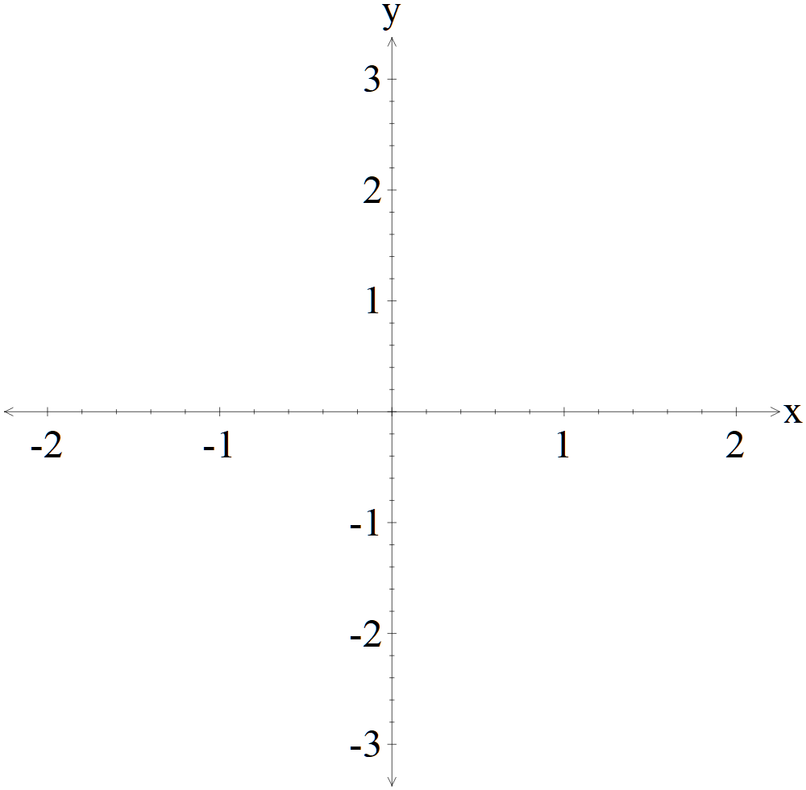
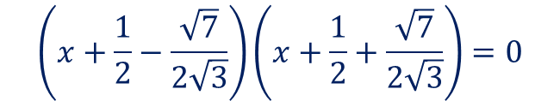

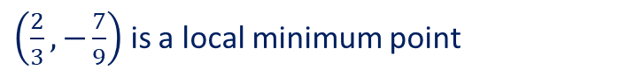

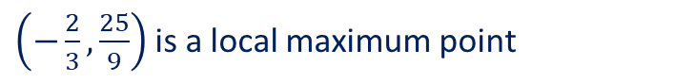
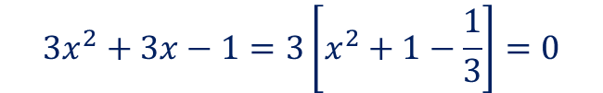
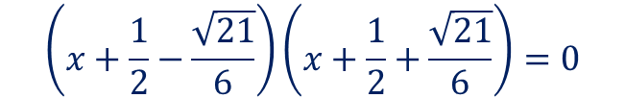

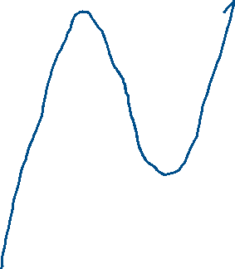
Guided Practice
Determine the stationary points and its nature of the function $f\left(x\right)=3x^{3}−4x+1$ . Sketch the graph of the function.
$$3x^{3}−4+1=(x−1)(3x^{2}+3x−1)$$
Intercepts are $∴\left(0,1\right), \left(1, 0\right), \left(−\frac{1}{2}+\frac{\sqrt{21}}{6},0\right),\left(−\frac{1}{2}−\frac{\sqrt{21}}{6},0\right)$
$$3x^{3}−4+1=\left(x−1\right)\left(3x^{2}+3x−1\right)=0$$
$\left(−\frac{2}{3},\frac{25}{9}\right)$is a local maximum point
$$∴x=1, 3x^{2}+3x−1=0$$
$$3x^{2}+3x−1=3\left[x^{2}+1−\frac{1}{3}\right]=0$$
$\left(\frac{2}{3},−\frac{7}{9}\right)$ is a local minimum point
$${\left(x+\frac{1}{2}\right)}^{2}−\frac{1}{4}−\frac{1}{3}=0$$
$${\left(x+\frac{1}{2}\right)}^{2}−\frac{7}{12}=0$$
$$\left(x+\frac{1}{2}−\frac{\sqrt{7}}{2\sqrt{3}}\right)\left(x+\frac{1}{2}+\frac{\sqrt{7}}{2\sqrt{3}}\right)=0$$
$$\left(x+\frac{1}{2}−\frac{\sqrt{21}}{6}\right)\left(x+\frac{1}{2}+\frac{\sqrt{21}}{6}\right)=0$$
$$∴ x=−\frac{1}{2}±\frac{\sqrt{21}}{6}$$

Slide 6
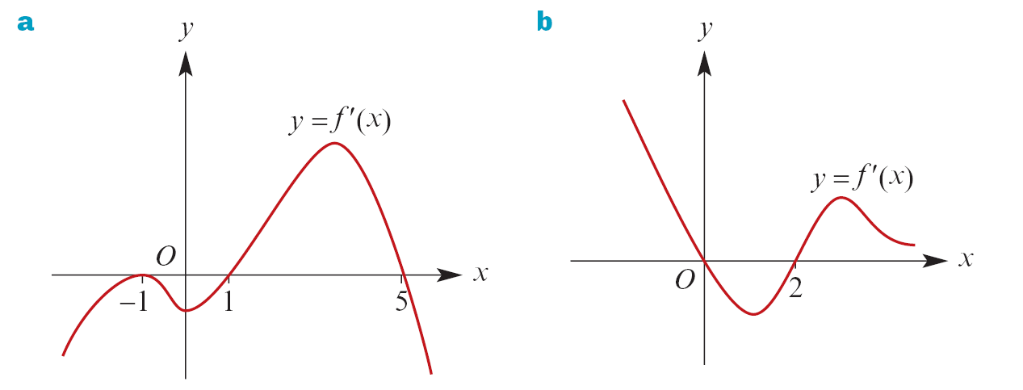


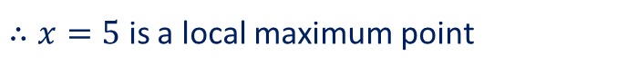
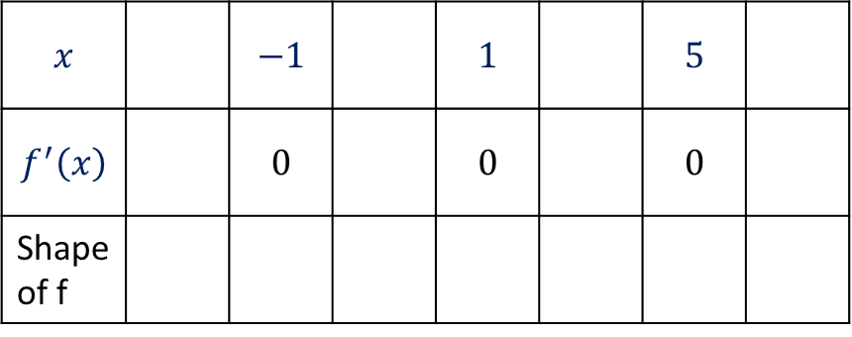
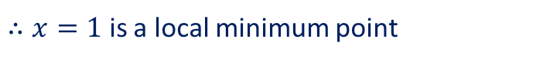
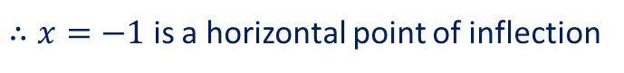


Guided Practice
Each graph below shows the graph of $f′$ for a function $f$. Find the values of $x$ for which the graph of $y=f(x)$ has a stationary point and state the nature of each stationary point.
Stationary points are at $f^{′}\left(x\right)=0$
$$∴x=−1, 1,5$$
$$x$$ |  | $$−1$$ |  | $$1$$ |  | $$5$$
$$f^{′}\left(x\right)$$ |  | $$0$$ |  | $$0$$ |  | $$0$$
Shape of f
$∴x=−1$ is a horizontal point of inflection
$∴x=1$ is a local minimum point
$$−$$
$$−$$
$$+$$
$$−$$
$∴x=5$ is a local maximum point

Slide 7

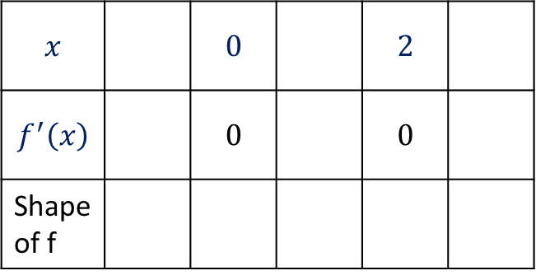
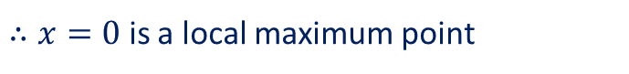
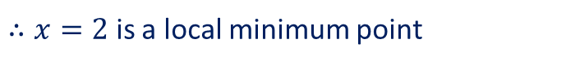
Guided Practice
Each graph below shows the graph of $f′$ for a function $f$. Find the values of $x$ for which the graph of $y=f(x)$ has a stationary point and state the nature of each stationary point.
Stationary points are at $f^{′}\left(x\right)=0$
$$∴x=0,2$$
$$x$$ |  | $$0$$ |  | $$2$$
$$f^{′}\left(x\right)$$ |  | $$0$$ |  | $$0$$
Shape of f
$∴x=2$ is a local minimum point
$∴x=0$ is a local maximum point
$$+$$
$$−$$
$$+$$

Slide 8
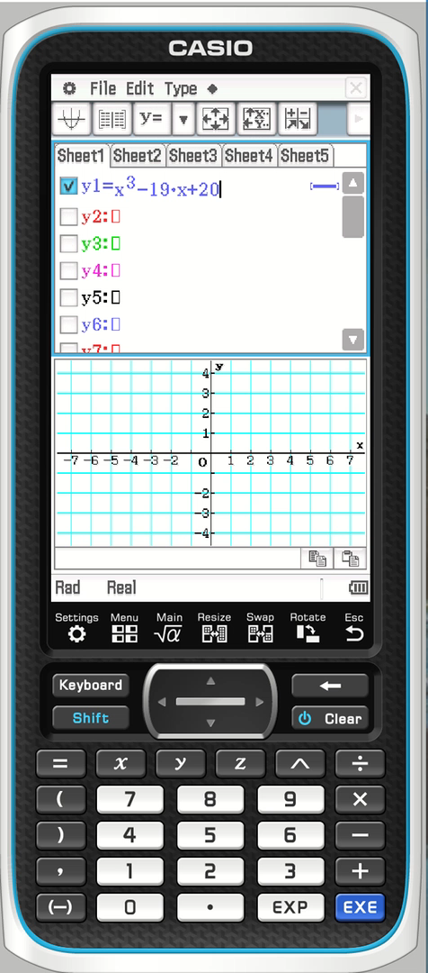
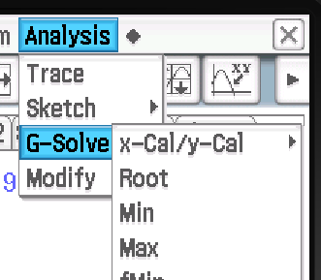
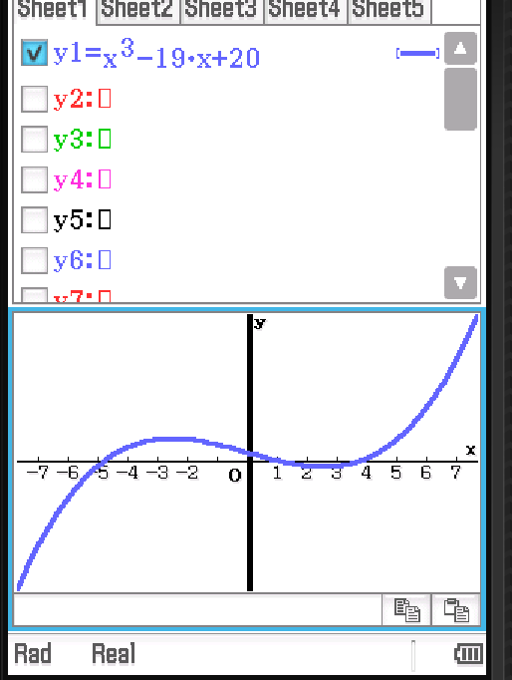
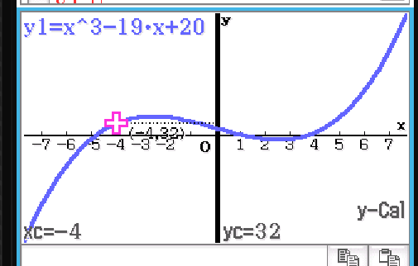
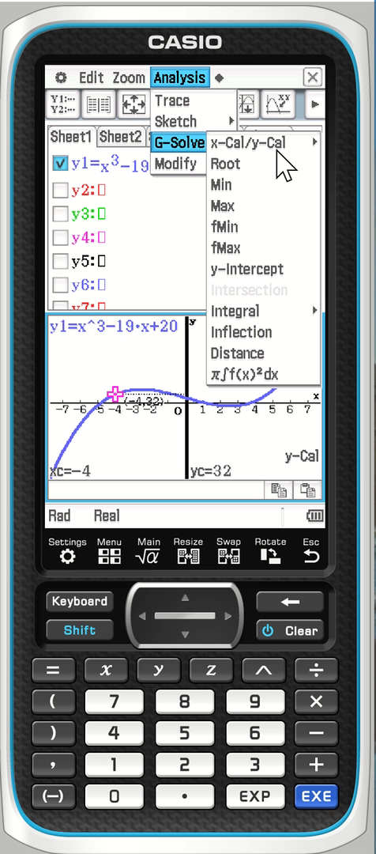
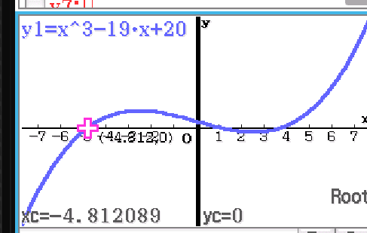
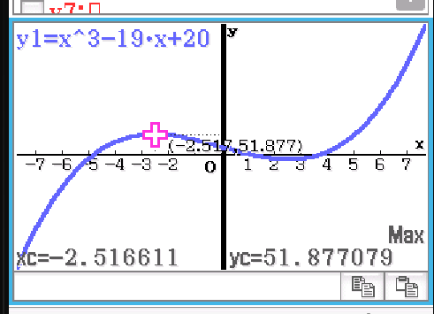
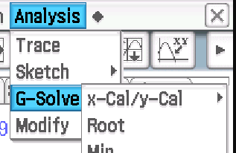
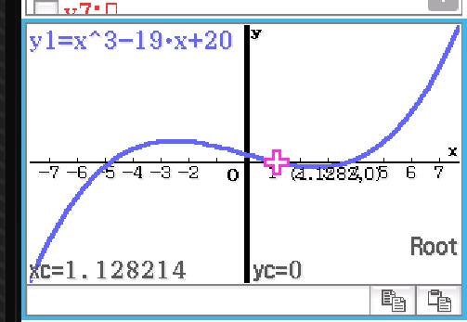
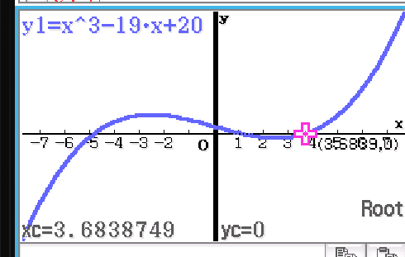
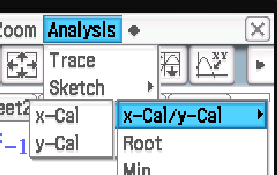
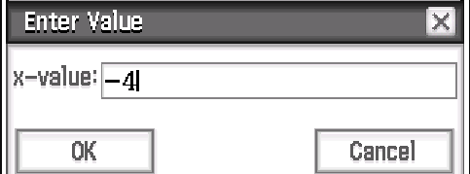


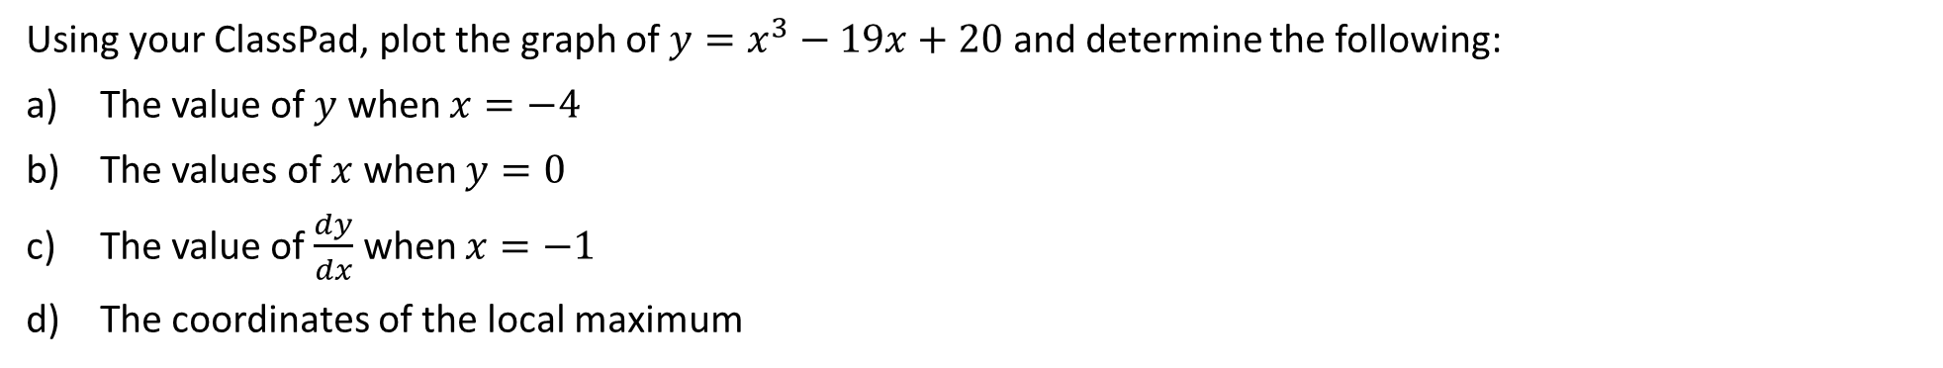


Guided Practice
Using your ClassPad, plot the graph of $y=x^{3}−19x+20$ and determine the following:
The value of $y$ when $x=−4$
The values of $x$ when $y=0$
The value of $\frac{dy}{dx}$ when $x=−1$
The coordinates of the local maximum

Slide 9
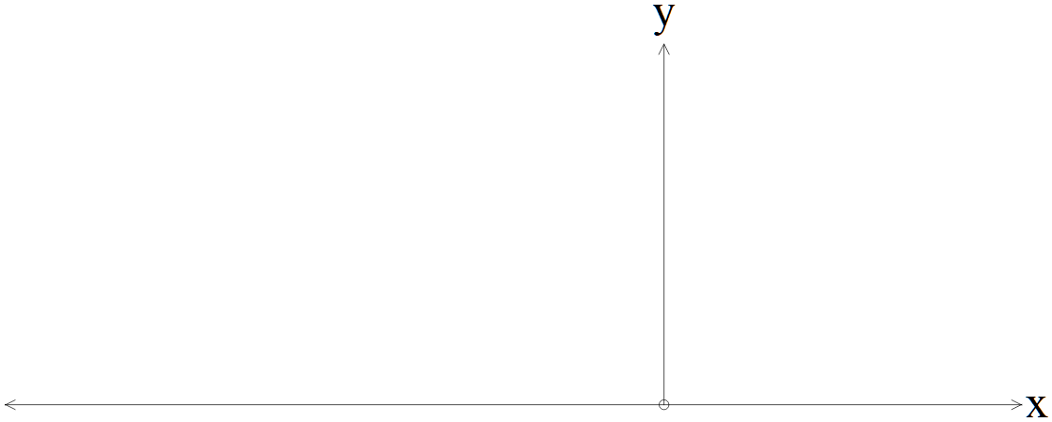
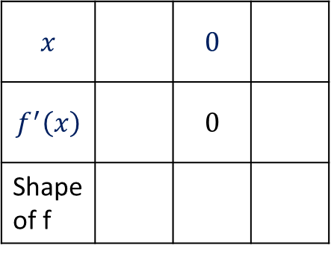







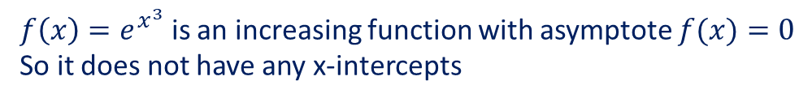




Guided Practice
Sketch the graph of $f\left(x\right)=e^{x^{3}}$
Behaviour of the graph: $x→∞, f\left(x\right)→∞$
Intercepts:
Sub $x=0, f\left(0\right)=e^{0}=1$
$f\left(x\right)=e^{x^{3}}$ is an increasing function with asymptote $f(x)=0$
So it does not have any x-intercepts
Stationary points:
$$f^{′}(x)=3x^{2}e^{x^{3}}$$
Sub $f^{′}\left(x\right)=0, 3x^{2}e^{x^{3}}=0$ $$∴x=0$$
$$x$$ |  | $$0$$
$$f^{′}\left(x\right)$$ |  | $$0$$
Shape of f
$$−1$$
$$1$$
$$+$$
$$+$$
$∴(0,1)$ is a point of inflection

Slide 10

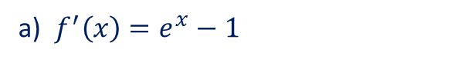
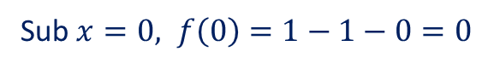
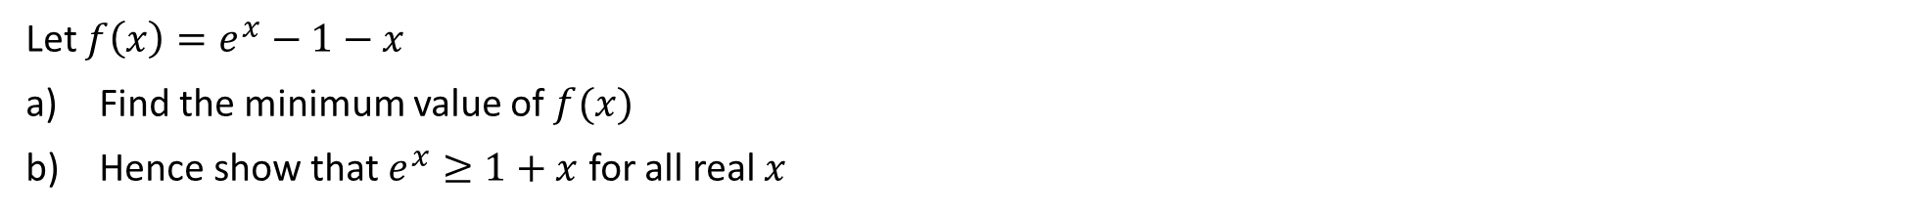

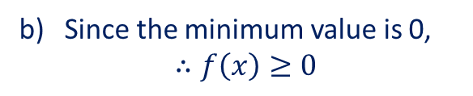
Guided Practice
Let $f\left(x\right)=e^{x}−1−x$
Find the minimum value of $f(x)$
Hence show that $e^{x}≥1+x$ for all real $x$
a) $f^{′}\left(x\right)=e^{x}−1$
Sub $f^{′}\left(x\right)=0, e^{x}−1=0$
$$e^{x}=1$$
$$x=0$$
Sub $x=0, f\left(0\right)=1−1−0=0$
Minimum value$, f\left(0\right)=0$
Since the minimum value is 0,
$$∴f\left(x\right)≥0$$
$$e^{x}−1−x≥0$$
$$∴e^{x}≥1+x$$

Slide 11

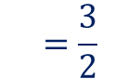






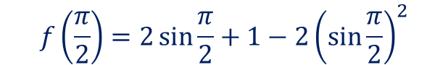

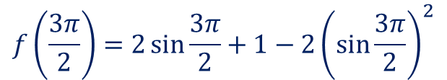

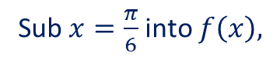




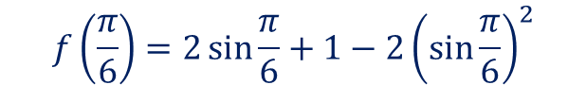






Guided Practice
Find the local maximum and local minimum points of $f\left(x\right)=2\sin{x}+1−2\sin^{2}{x}$ where $0<x<2π$
$f^{′}\left(x\right)=2\cos{x}−4\sin{x}\cos{x}$
Sub $x=\frac{π}{2}$ into $f\left(x\right),$
Sub $f^{′}\left(x\right)=0, 2\cos{x}−4\sin{x}\cos{x}=0$
$$f\left(\frac{π}{2}\right)=2\sin{\frac{π}{2}+1−2{\left(\sin{\frac{π}{2}}\right)}^{2}}$$
$$2\cos{x}\left(1−2\sin{x}\right)=0$$
$$=1$$
$$2\cos{x}=0, 1−2\sin{x}=0$$
Sub $x=\frac{3π}{2}$ into $f\left(x\right),$
$$\cos{x}=0, \sin{x}=\frac{1}{2}$$
$$f\left(\frac{3π}{2}\right)=2\sin{\frac{3π}{2}+1−2{\left(\sin{\frac{3π}{2}}\right)}^{2}}$$
$$x=\frac{π}{2},\frac{3π}{2}$$
$$x=\frac{π}{6},\frac{5π}{6}$$
$$=−3$$
$$x$$ |  | $$\frac{π}{6}$$ |  | $$\frac{π}{2}$$ |  | $$\frac{5π}{6}$$ |  | $$\frac{3π}{2}$$
$$f^{′}\left(x\right)$$ |  | $$0$$ |  | $$0$$ |  | $$0$$ |  | $$0$$
Shape of f
Sub $x=\frac{π}{6}$ into $f\left(x\right),$
$$f\left(\frac{π}{6}\right)=2\sin{\frac{π}{6}+1−2{\left(\sin{\frac{π}{6}}\right)}^{2}}$$
$$+$$
$$−$$
$$+$$
$$−$$
$$+$$
$$=2\left(\frac{1}{2}\right)+1−2\left(\frac{1}{4}\right)$$
$$=\frac{3}{2}$$
Sub $x=\frac{π}{6}$ into $f\left(x\right),$
Local Max: $\left(\frac{π}{6},\frac{3}{2}\right), \left(\frac{5π}{6},\frac{3}{2}\right)$
$$f\left(\frac{5π}{6}\right)=\frac{3}{2}$$
Local Min: $\left(\frac{π}{2},1\right), \left(\frac{3π}{2},−3\right)$

Slide 12











Guided Practice
A dilation of factor $p$ parallel to the $y$ axis
A translation of $l$ units in the positive direction of the $x$ axis
$⇒$ Multiply all $y−$ coordinates by $p$
$⇒$ add $l$ to $x−$ coordinates
$$A\left(a,0\right)⇒A′(a, 0)$$
$$⇒A′′(a+l, 0)$$
$$B\left(b,0\right)⇒B′(b, 0)$$
$$⇒B′′(b+l, 0)$$
$$P\left(h,k\right)⇒P′(h, pk)$$
$$⇒C′′(h+l, pk)$$

Slide 13
Independent Practice
Complete Cambridge Ex 5E exclude Q20, 21

